Slide 1
My Screen Time Analysis

Slide 2
Analysis scope
Subject
1
My screen time
Problem
2
Spending too much time on my phone
Goal
3
Limit daily screen time to not more than 2 hours
Question
4
What encourages me to spend so much time on my phone?

Slide 3

Collected data
Data collected
Daily screen time usage (h). Including time spend on most used apps
Daily number of notifications received
Daily number of phone unlocks
Data source
Samsung Digital Wellbeing app
Observations
27 observations to reflect daily screen time usage

Slide 4
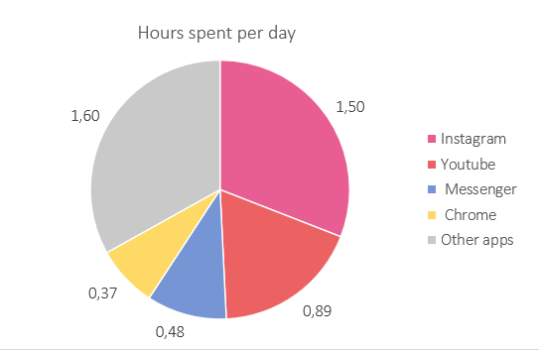
How much time do I spend on each app?
4.84h
Daily screen time on average

Slide 5
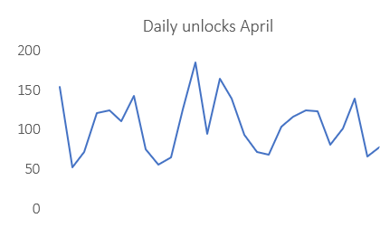
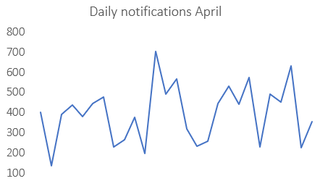
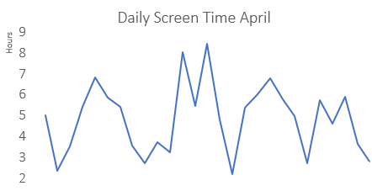
Trends
Conclusion
Not all days have consistent phone usage
Phone unlocks, notifications and screen time varies significantly throughout the days
Relationship
Conclusion
Phone unlocks, notifications and screen time show similar patterns
Possible correlation between unlocks, notifications, and screen time

Slide 6
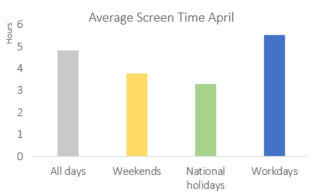
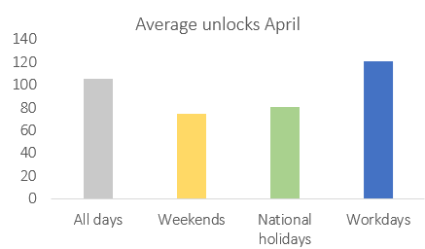
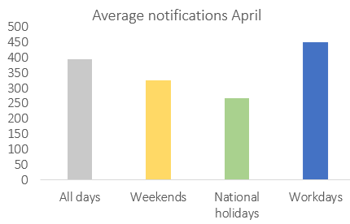
Workdays
Weekends
Keep my phone up for longer periods during weekends
More screen time during workdays compared to National holidays and weekends

Slide 7
Conclusions
Workdays
59%
Is when I generate most of screen time
The percentage by which I need to reduce my screen time to achieve the goal
Weekends
Instagram
Is when I spend longer time periods on my phone
The app that takes the highest proportion of my screen time
Other apps
Notifications
Is second category by time consumption after the Instagram
Have relationship to the time spent on my phone

Slide 8
Actions to be taken
Notifications
1
Mute notifications
Apps
2
Delete some apps that belong to Other apps category
Activities
3
More activities outside that are similar to what I do on weekends
Duration
4
Put time limits for one unlock during the weekend

